Slide 1
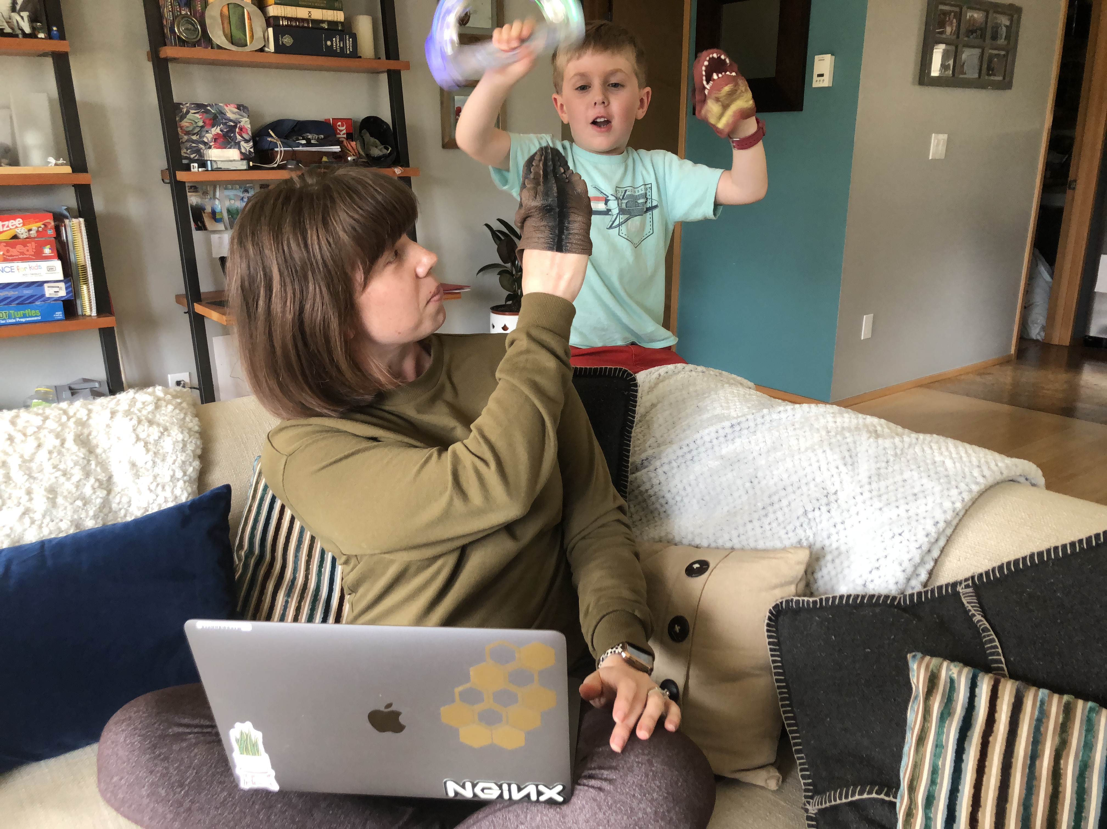
Managing…
Replace with photo of yourself working from home
Stress,
Uncertainty,
and
Remote Work
with [your name here]
Notes:
Slide Purpose: Introduction
Timing: 5 minutes
DO:
Turn on your webcam
Welcome participants
Introduce yourself, what you do for your “day job” and why you wanted to facilitate this workshop.
Acknowledge that we’re all going through stressful events, including the pandemic, racial injustice and police brutality.
Wait to advance to the next slide until about 5 minutes past the scheduled meeting start time.
SAY:
Welcome!
You can come off mute at any time to talk to me, or others in the session. This workshop will be more fun and effective if we treat it less like a classroom and more like a community.

Slide 2
Part 1:
Increase
Your
Wellness
Part 2:
Support
Each Other
Notes:
Slide Purpose: Session Overview
Timing: <1 minute
DO
Share the workshop outcomes
A process for improving your personal wellness.
Support each other in a “human first” way.

Slide 3
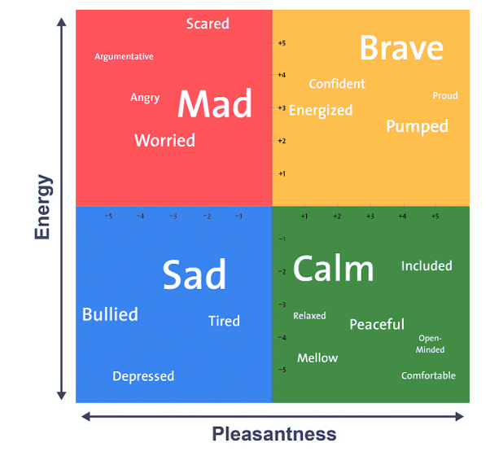
Anonymous Zoom Poll:
How are you feeling right now?
Notes:
Slide Purpose: Introduce the Mood Meter
Timing: 5 minutes
SAY:
We are going to start with a self-awareness exercise. Has anyone used the Mood Meter before?
The Mood Meter is a mindfulness and self-awareness tool developed by Yale. It’s used in schools to help children develop an awareness of their emotions and how those emotions impact their behavior.
To use the mood meter, you rate how you’re feeling on an X,Y axis.
The X axis indicates how much energy you have, from low to high, while the Y axis indicates how pleasant you’re feeling.
It’s important to understand that there is no right or wrong place to be on the Mood Meter, and in fact there are advantages to be found with each quadrant.
BLUE feelings: low in energy and low in pleasantness (e.g., sad, depressed, lonely)
GREEN feelings: low in energy and high in pleasantness (e.g., calm, tranquil, relaxed)
RED feelings: high in energy and low in pleasantness (e.g., angry, scared, anxious)
YELLOW feelings: high in energy and high in pleasantness (e.g., happy, excited, pumped)
DO:
Launch Poll 1
Display Results and remind people that wherever they are, that’s ok.
We will do this exercise two more times during the workshop. back to this later.

Slide 4
stress
/stres/
noun
a state of physical, mental or emotional strain experienced when you encounter a threat.
Notes:
Slide Purpose: What is stress?
Timing: <1 minute
DO:
Explain why stress is a normal and essential part of human biology
SAY:
Stress is a state of physical, mental, or emotional strain experienced when you encounter a threat.
Stress is our body’s way of telling us that there is a threat, which from an evolutionary perspective is a good thing because it’s kept the human race alive.
Stressors can range from exciting events, like getting a new job or getting married, to negative pressures like relationship problems or a death of a loved one
One stressor that is universal is the stress brought on by uncertainty.

Slide 5
un·cer·tain
/ˌənˈsərtn/
adjective
not able to be relied on;
not known or definite.
Notes:
Slide Purpose: Why does uncertainty stress us out?
Timing: 3 minutes
DO:
Facilitate a brief conversation on why uncertainty is a major stressor for humans.
SAY:
Why do you think uncertainty is a big stressor? Feel free to unmute or use the Zoom chat.
When things are uncertain, our brains have a hard time making decisions.
Predictability offers a perceived control over our environment.
The future is inherently uncertain, but right now, we’re arguably in one of the most uncertain points in human history.
The things we’re uncertain about relate back to some of our most basic needs: security and family.
Not knowing when we can start safely going out in public, or when we can visit loved ones, or when our kids can go back to school. These things are all outside our control and that uncertainty wears on us every day.

Slide 6
Threat Levels
Level 1
Level 2
Level 3
Notes:
Slide Purpose: Threat Levels
Timing: 1 minute
SAY:
The NeuroLeadership Institute, which specializes in brain-based research applied to everyday life, recognizes three levels of threat. Our threat levels reflect the stress we’re experiencing.
Level 1 threats are in your broader environment. You’re aware of the threat, but your fight or flight response hasn’t kicked in. You can still do your job, maintain your relationships, and go about your life. Think of this threat as the hurricane that your local weather person says is moving toward your region.
CLICK (Level 2 animation)
SAY:
Level 2 threats are those in your neighborhood, when your brain starts signaling to your body to prepare for a fight or flight response. You may become hyper-alert and feel a bit alarmed. You lose productivity and the ability to communicate well. This is when the hurricane makes landfall close by.
CLICK (Level 3 animation)
SAY:
Level 3 threats happen when you feel like a danger is right upon you. You experience intense panic. Your body actively recruits every resource to fight or flee. Minimal complex thought takes place in the brain. In our hurricane example, this is the hurricane storming through your town.

Slide 7
Level 3
Level 2
During COVID-19
Level 1
Before COVID-19
Notes:
Slide Purpose: Threat Levels
Timing: up to 5 minutes
DO:
Facilitate a conversation on threat levels
SAY:
Where do you think your stress level would be on a regular workday before the pandemic?
You can use the chat to indicate the level, or you can use the Zoom annotation option to mark the chart.
CLICK (Before COVID-19 animation)
SAY:
Most people have a baseline below Level 1.
As a result of the pandemic, where do you think most people are now? Again, use the chat or annotate.
CLICK (During COVID-19)
NeuroLeadership Institute research indicates that over 50% of people are at a constant level 2 or higher.
What do you think are the consequences of being at a sustained high threat level?

Slide 8
Threat Levels - Impacts
We default to
self-protective
behaviors
Withdraw from others
Stop collaborating
Essentially shut down
Level 2
Level 3
Notes:
Slide Purpose: Impact of being at higher threat levels
Timing: <1 minute
DO:
Summarize the consequences of being at Levels 2 and 3
SAY:
Levels 2 and 3 are extremely helpful for accomplishing life-or-death physical tasks, like running or jumping.
When we’re in these states, we default to self-protective behaviors. We withdraw from others, stop collaborating, and essentially shut down.
Only by reducing threat to Level 1 will we see an improvement in our ability to think deeply and connect to one another.
Managers can help their teams by being empathetic, celebrating wins and progress, being clear about priorities and timelines, and giving us autonomy and flexibility.
The good news, there’s also a lot that we can do for ourselves and each other if we decide to be intentional. I’m going to share a simple process for increasing your wellness.

Slide 9
Increase My Wellbeing
1
Step 1: Recognize My Unique Signs of Stress
Feelings of
Numbness
Disbelief
Anxiety
Fear
Anger
Irritability
Sadness
Changes in
Appetite
Use of alcohol, tobacco, or other drugs
Energy/activity level
Temper
Difficulty with
Concentrating
Sleeping
Physical reactions, such as:
Headaches
Body pains
Stomach problems
Skin rashes
Worsening of chronic health problems
Other _________________________
Step 2: Identify Stress Reducers that Work for Me
Take breaks from
News stories (including social media)
Responsibilities (including work and parenting)
My computer/Zoom
Change my diet
Eat healthier snacks and meals
Drink more water
Avoid alcohol and drugs
Connect with
My family
My friends
A mental health provider
Add or increase
Deep breathing
Stretching
Exercise
Meditation
Sleep
Favorite or new hobbies
Time Outside
Other
Take 2-3 minutes to complete just this page.
gardening
Acne!
Notes:
Slide Purpose: Introduce Page 1 of worksheet
Timing: 5 minutes
SAY:
I am going to introduce you to a simple 3-part process for improving your wellness.
First, you will recognize your unique signs of stress (review the signs – sourced from CDC and NLI)
Next, you will identify stress reducers that work for you – especially those that might alleviate specific signs of stress
DO:
Use the Zoom chat to send the worksheet
CLICK (instructions animation)
SAY:
I am going to set a timer for 2 minutes, and then I’ll check in on how you’re doing. Please do only Page 1.
DO:
Set a timer for 2 minutes.
While waiting, set up the breakout rooms so that each room has 3-4 people. Pull out anyone who indicated they don’t want to participate.
At end of 2 minutes: Ask anyone who has completed the worksheet to type 1 in the chat. Depending on the responses, give more time or move to the next slide.

Slide 10
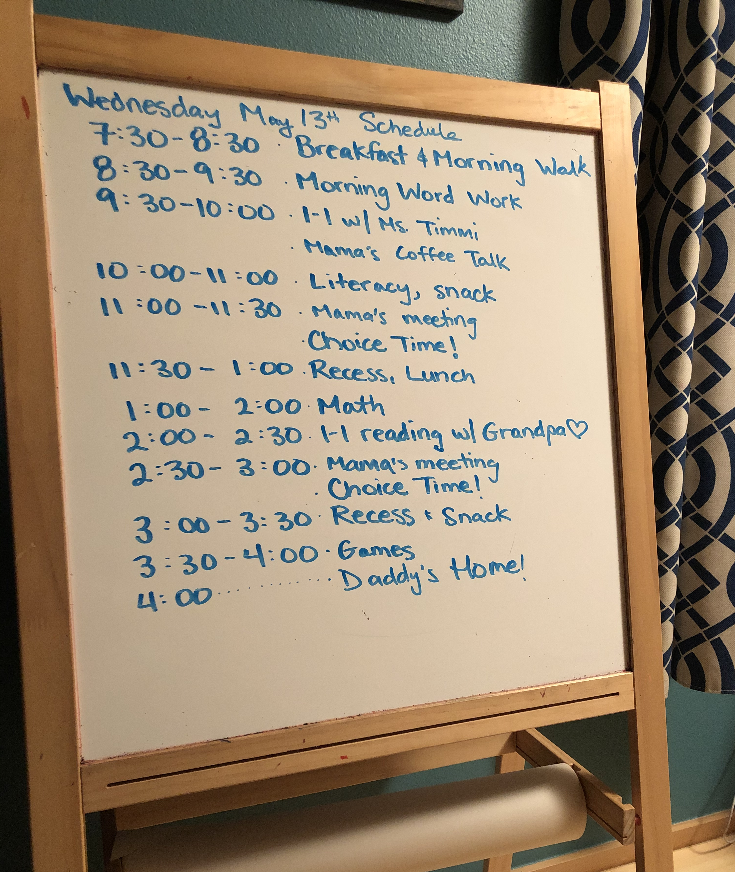
Successful Goal Setting
Start small
Be specific
Anchor to current behaviors/habits
Make a schedule
Use calendar to block time
Get an accountability buddy
Notes:
Slide Purpose: Share successful goal setting elements
Timing: <1 minute
SAY:
In just a moment, I’m going to have you use the work you’ve done to set personal wellness goals.
First I want to review some components to successful goal setting
DO:
Review the list
Add any personal examples of what has helped you be successful in achieving goals
Emphasize that wellness goals don’t need to be stretch goals; when you’re trying to improve your wellness it is better to set some small, attainable goals so that you can generate some momentum before trying something more challenging.

Slide 11
Increase My Wellbeing
2
Step 3: Set Wellness Goals
Over the next week I will…
Goal 1
Goal 2
Goal 3
Go for a 15-minute walk each morning
Get a glass of water before each meeting
Sign up for Talkspace
Take 10 minutes to share what you’re comfortable sharing from Page 1, and brainstorm on attainable wellness goals.
Notes:
Slide Purpose: Set Accountability Goals
Timing: 12 minutes
SAY:
On the Page 2 of your digital handout, you will find a simple worksheet for setting your goals.
These are some sample goals that happen to be my personal wellness goals.
CLICK (breakout instructions)
SAY:
I am going to put you in breakout groups of 3-4 people.
I would like you to share what you’re comfortable sharing from Page 1, and then brainstorm together on your wellness goals. You’ll have 10 minutes to work together.
If you’ve never used the Zoom breakout room functionality, here’s what to expect:
You’ll move into a separate digital space where no one else in the meeting can see or hear your group conversations.
I can communicate with you through broadcasting messages, but they’re subtle and tend to get missed.
I’ll close the breakout rooms after the allotted time, and you’ll have the option to immediately return to the main room, or take up to 60 seconds to wrap up your conversations.
DO:
Start breakout rooms and set a timer for 9 minutes.
When it goes off, broadcast the message “1 minute left” and set a new timer for 1 minute.
When it goes off, close the breakout rooms. Greet people as they return.

Slide 12
Anonymous Zoom Poll:
How are you feeling right now?
Notes:
Slide Purpose: Mood Meter Check-in
Timing: 2 minutes
SAY:
We’re halfway through this session, and it’s time to see how you are feeling.
Again, I’m going to put up an anonymous Zoom poll.
DO:
Launch the poll. When complete, display the results.
Likely there has been a shift in moods. Ask for people to unmute or chat their theories on why it’s changed.

Slide 13
Remote Work
Notes:
Slide Purpose: Group conversation about remote work
Timing: 5 minutes
SAY:
Now we’re going to transition to the second half of the workshop, where we’ll talk about how to support each other as remote workers during a pandemic.
Under normal circumstances, remote work can be just as, if not more productive, than office-based work. It has great benefits towards worker satisfaction, employee retention, and overall productivity.
But forced remote work coupled with a stay-at-home order is different. In order to be effective, we need to be intentional about supporting each other and having reasonable expectations of what everyone can accomplish.
I think for most people, remote work is new. I’d like to do a quick poll to see how you’re feeling about it.
DO:
Launch the 3-question poll. When complete, display the results.
Ask people to volunteer to talk about their experiences with remote work

Slide 14
Remote Work
Using the Zoom Chat…
What has been positive about being a remote team?
What has been negative about being a remote team?
Notes:
Slide Purpose: Group conversation about remote work
Timing: 8 minutes
SAY:
Now that we’re a few months into being a 100% remote team, it’s a good time to reflect on how it’s been working.
Let’s first think about some positive outcomes – both for you and for your team.
Please unmute or use the chat to list the positive outcomes of being a team of remote workers
DO:
Facilitate conversation, looking for themes.
CLICK (thumbs down animation)
SAY:
Next, what are some negative outcomes, or things you miss about going to an office?
Again, unmute or use the chat to share your experiences.

Slide 15
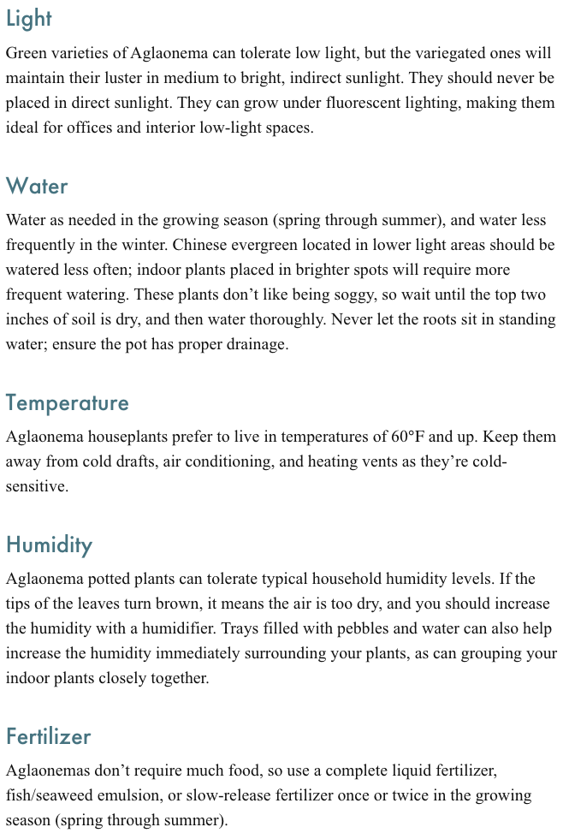
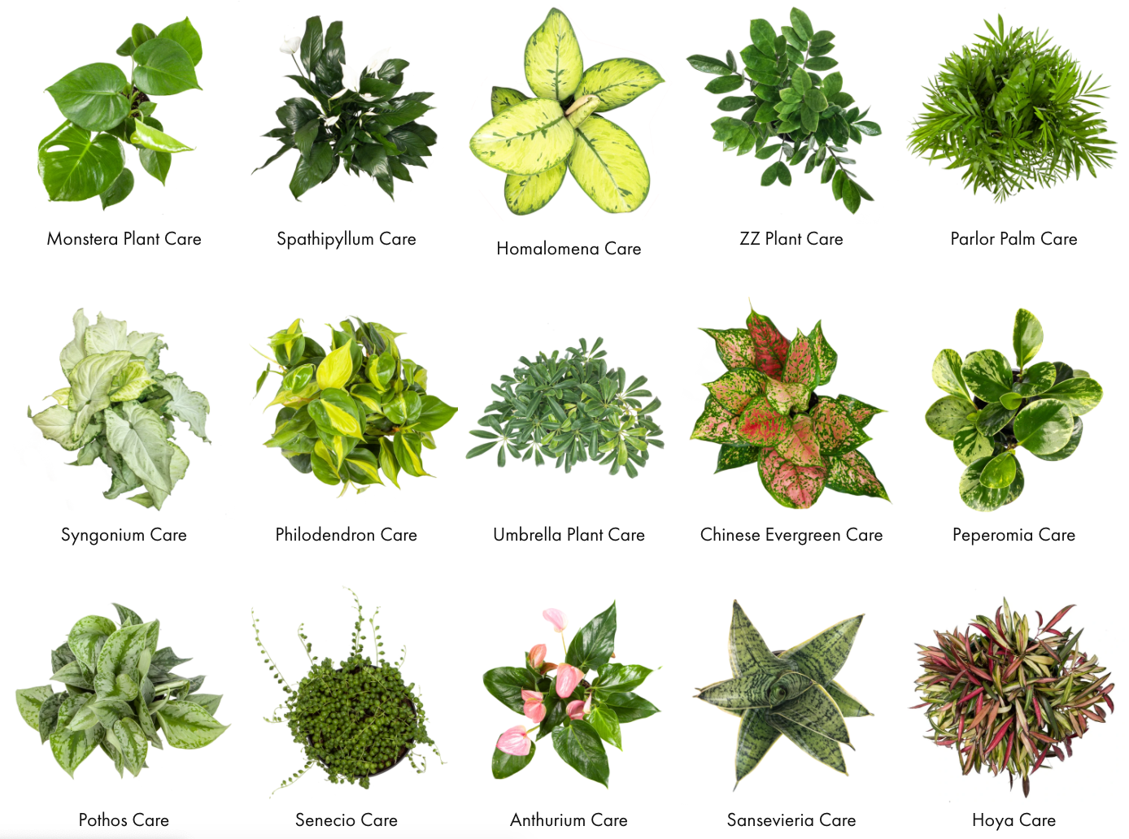
Notes:
Slide Purpose: Introduce individual needs
Timing: 1 minute
SAY:
I’m going to go way off topic and talk to you about plants.
Every plant is a little different. They have different needs when it comes to light, water, temperature, humidity, food.
You might be able to get away with neglecting one or two needs, but changes are also good that the plant will become susceptible to diseases and bugs.
Plant parents do a lot of research on what each plant baby needs to thrive, and they treat each one accordingly.
Ask: Tell me, Why am I talking about plants?
Because people are just as diverse, and if we don’t know what they need, we can’t take care of each other.

Slide 16
My Care Instructions
3
I wish my team knew:
I can offer:
I need to protect:
that I’m solo parenting my 6-year-old because my husband can’t telework. Because of this, back-to-back and last-minute meetings are really challenging and exhausting.
to be available for 45-minute meetings (so we get breaks!) and will check in after my son goes to bed.
my lunch (12-1pm) because I get “hangry” and would be no fun to be in a meeting with anyway ☺️
Take 5 minutes to complete this page.
Take 10 minutes to share what you wrote
with your small group.
Notes:
Slide Purpose: Support Each Other
Timing: 18 minutes
SAY:
Unlike plants, we don’t have care tags. It’s up to us to voice our needs.
To help you do that, we have another simple exercise.
First, you’ll write something you wish your team knew about you that would explain a unique situation or stress you’re experiencing. In my situation (read sentence).
Next, write what you can offer to your team. This might be about your availability, or it could be a talent you have or a way you can help.
Finally, what do you need to protect?
I’m going to give you about 5 minutes to work on this on your own, and then I’ll put you back in your breakout groups.
DO:
Set timer for 4 minutes. At the end, tell people to type a 1 in the chat if they’re done. (As before, evaluate how many people are still working vs are ready)
CLICK (breakout animation)
SAY:
I’m going to put you back in your breakout rooms, where you’ll share what your comfortable sharing.
DO:
Start breakout rooms and set a timer for 9 minutes. When it goes off, broadcast the message “1 minute left”.
Set a timer for 1 minute. When it goes off, close the breakout rooms and advance to the next slide.

Slide 17
What are Your Care Instructions?
Notes:
Slide Purpose: What are your Care Instructions?
Timing: 5 minutes
SAY:
I hope you had some great conversations.
It can be really inspiring and freeing to share your care instructions here in the workshop.
If you’re comfortable, paste part of your care instructions in the chat, or unmute and we can talk about it.
You can also share what you learned through this process.
DO:
Facilitate conversation on what people share/learned.

Slide 18
Anonymous Zoom Poll:
How are you feeling right now?
Notes:
Slide Purpose: Final Mood Meter
Timing: 2 minutes
SAY:
Now that we’re nearing the end of our time together, I want to know how you’re feeling.
Again, I’m going to put up an anonymous Zoom poll
DO:
Launch poll, then display results.
Likely there has been a shift in moods. Ask for people to unmute or chat their theories on why it’s changed.

Slide 19
Notes:
Slide Purpose: Closing
Timing: <1 minute
SAY:
Thank you everyone for your time and engagement today
Before we close, I want to encourage you to be kind to yourselves
We’re going through unprecedented stress and uncertainty, and you’ll have both good and bad days
You might not master your new habits immediately, but don’t give up!

